Slide 1

AD-AS Model
Output Gap
AD-AS model : Aggregate Demand and Aggregate Supply
SRAS v. LRAS
Shocks in an economy: Positive/Negative Shocks and Demand/Supply Shocks
Stagflation period
To First
Active Learning
To Video

Slide 2
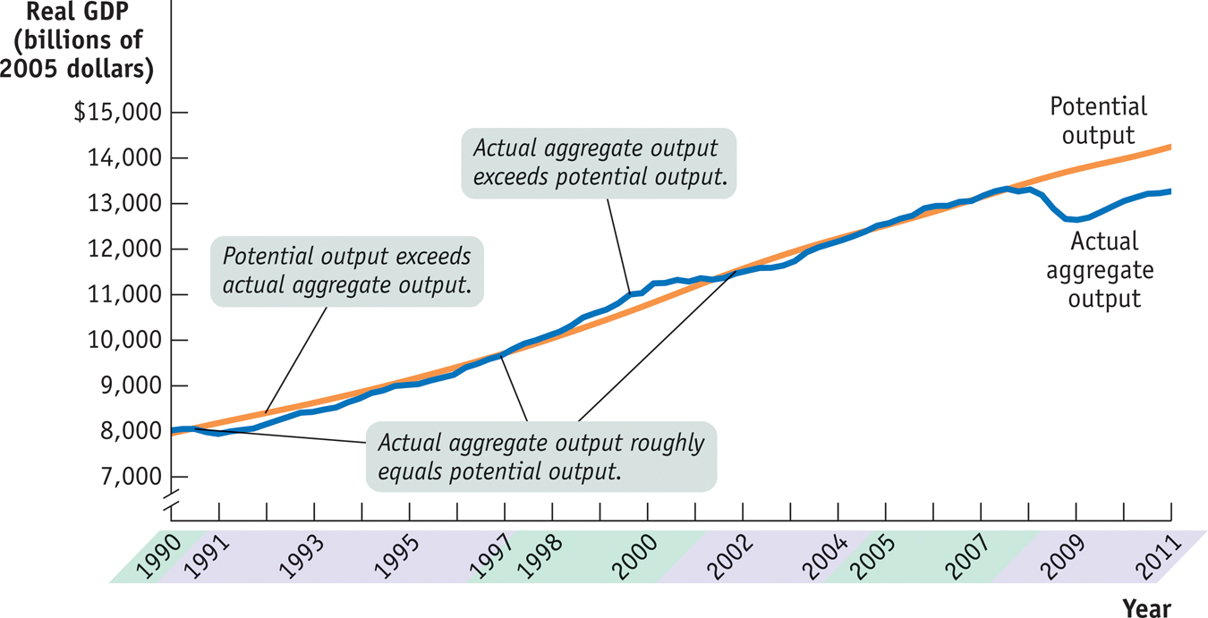
Actual and Potential Output, 1989–2013
The level of real GDP is almost always either above or below potential output because of short-run fluctuations.
Sources: Congressional Budget Office; Bureau of Economic Analysis.
Notes:
2

Slide 3
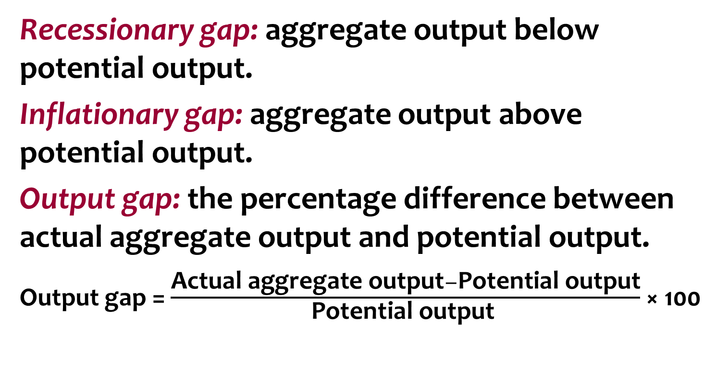
Output Gap
whY
Ye < Yp
Ye > Yp
(Ye – Yp)/Yp x 100%
Policy makers can attempt to move us back to potential output by aggressive policies(Keynesian)
But the economy may correct itself in the long run if wages and prices fully adjust (Classical).

Slide 4


Shocks to the System
What causes recessions?
Why is inflation high in some recessions and not in others?
The economy’s behavior can be explained, predicted, and potentially manipulated by looking at:
total (aggregate) demand -- AD
total (aggregate) supply -- AS
AD–AS model is used to analyze economic fluctuations
How monetary policy and fiscal policy can stabilize the economy

Slide 5
The AD–AS Model
Aggregate price level
SRAS
Short-run equilibrium aggregate price level
P_{E}
E_{SR}
Short-run macroeconomic equilibrium
AD
Short-run equilibrium output
Y_{E}
Real GDP
Notes:
5

Slide 6
The Aggregate Demand Curve
Aggregate price
level (GDP deflator,
2005 = 100)
Aggregate demand curve: the relationship between the aggregate price level and the quantity of aggregate output demanded by households, businesses, the government, and the rest of the world.
1933
A movement down the AD curve leads to a lower aggregate price level and higher aggregate output.
7.9
4.2
Aggregate demand
curve, AD
0
716
1,000
Real GDP (billions of 2005 dollars)
Notes:
6

Slide 7
The Shape of the Aggregate Demand Curve
Recall: GDP = C + I + G + X − IM
A rise in the aggregate price level reduces C, I, and X − IM
Two reasons:
The wealth effect: A higher aggregate price level reduces the purchasing power of households’ wealth and reduces consumer spending.
The interest rate effect: A higher aggregate price level makes households hold more money (to buy the same amount of goods) and leads to a rise in interest rates (and a fall in investment spending and consumer spending).

Slide 8
Shifts of the Aggregate Demand Curve
(a) Rightward Shift
(b) Leftward Shift
Aggregate price level
Aggregate price level
Decrease in aggregate demand
Increase in aggregate demand
The AD curve shifts because:
expectations
Wealth
physical capital
government policies
Fiscal policy
Monetary policy
AD₂
AD₂
AD₁
AD₁
Real GDP
Real GDP
Notes:
8

Slide 9
If the economy is in equilibrium and the real estate market collapses, what will likely happen?
The AD curve will shift rightward.
The AD curve will shift leftward.
The SRAS curve will shift rightward.
The SRAS curve will shift leftward.
To Next
Active Learning

Slide 10
The Short-Run Aggregate Supply, SRAS Curve
Aggregate price
level (GDP deflator,
2005 = 100)
A movement down
the SRAS curve leads
to deflation and lower
aggregate output.
Short-run aggregate
supply curve, SRAS
10.6
AS curve shows the relationship between the aggregate price level and the quantity of aggregate output in the economy.
1929
7.9
1933
0
716
976
Real GDP (billions of 2005 dollars)
Notes:
10

Slide 11


The SRAS Curve
Why does the SRAS curve slope upward?
Because nominal wages are “sticky” in the short run
Nominal wage: the dollar amount of the wage paid.
Sticky wages: nominal wages that are slow to fall even in the face of high unemployment and slow to rise even in the face of labor shortages.
Nominal wages are often determined by contracts that were signed some time ago. Even when there are no formal contracts, there are often informal agreements between management and workers.
A higher aggregate price level leads to higher profits and increased aggregate output in the short run.
Profit = price − production cost
Many firms are in very competitive industries, so they have no control over price. Some aren’t—and can raise price when demand is strong.
(more support for the positive slope of the SRAS)

Slide 12
Shifts of the Short-Run Aggregate Supply Curve
(a) Leftward Shift
(b) Rightward Shift
Aggregate price level
Aggregate price level
SRAS₂
SRAS₁
SRAS₂
SRAS₁
The SRAS curve shifts because of changes in:
commodity prices.
nominal wages.
Productivity.
Decrease in short-run
aggregate supply
Increase in short-run
aggregate supply
Real GDP
Real GDP
Notes:
12

Slide 13
The short-run aggregate supply, SRAS curve will shift to the right when:
when input costs rise.
when taxes rise.
when interest rates rise.
when productivity rises.
To Next
Active Learning

Slide 14

What Happens When There Is a Shock?
If a demand or supply shock, negative or positive, hits the economy,
AD or SRAS shifts and moves the economy to a new short-run equilibrium.

Slide 15
Shifts of AD: Short-Run Effects
A negative demand shock: Total spending falls.
Aggregate price level
A negative demand shock...
SRAS
P₁
E₁
...leads to a lower aggregate price level and lower aggregate output.
P₂
E₂
AD₁
AD₂
Y₂
Y₁
Real GDP
Notes:
15

Slide 16
Shifts of Aggregate Demand: Short-Run Effects
A positive demand shock: Total spending rises.
Aggregate price level
A positive demand shock...
SRAS
...leads to a higher
aggregate price
level and higher
aggregate output.
P₂
E₂
P₁
E₁
AD₂
AD₁
Y₁
Y₂
Real GDP
Notes:
16

Slide 17
Shifts of the SRAS Curve
A positive supply shock: a decrease in oil price, or increase in productivity due to technology
Aggregate price level
A positive supply shock...
SRAS₁
SRAS₂
E₁
P₁
...leads to higher
aggregate output, lower aggregate price level.
P₂
E₂
AD
Y₁
Y₂
Real GDP
Notes:
17

Slide 18
Shifts of the SRAS Curve
A negative supply shock: oil crisis: Total production falls at every price level. This has “double” negative impacts.
Aggregate price level
A negative supply shock...
SRAS₂
SRAS₁
E₂
P₂
...leads to a lower aggregate output and a higher aggregate price level.
P₁
E₁
AD
Y₂
Y₁
Real GDP
Notes:
18

Slide 19

Negative Supply Shocks and Stagflation
Especially nasty for society is stagflation: the combination of inflation and falling aggregate output that comes with a negative supply shock.

Slide 20
Dilemma in Responding to Negative Supply Shocks
Negative supply shocks pose a policy dilemma:
- To stabilize aggregate output requires increasing aggregate demand. This will lead to inflation.
- But to stabilize prices requires reducing aggregate demand. This will deepen the output slump.
In the 1970s, during the Stagflation, the Government had to choose what policy to conduct:
expansionary (increasing) or contractionary (reducing).

Slide 21
Long-Run Aggregate Supply Curve
Aggregate price
level (GDP deflator,
2005 = 100)
Long-run aggregate
supply curve, LRAS
…leaves the quantity
of aggregate output
supplied unchanged
in the long run.
15.0
A fall in the
aggregate
price level…
Potential output, Yp, is the level of real GDP the economy would produce if all prices, including nominal wages, were fully flexible.
7.5
0
Potential
output, Y_{P}
$800
Real GDP (billions of 2005 dollars)
Notes:
21

Slide 22
Long-Run Macroeconomic Equilibrium
The economy is in long-run macroeconomic equilibrium when the point of short-run macroeconomic equilibrium is on the LRAS curve → no output gap
This economy is in short run AND long-run macroeconomic equilibrium.
Aggregate price level
LRAS
SRAS
P_{E}
E_{LR}
Long-run macroeconomic equilibrium
AD
Y_{P}
Real GDP
Potential output
Notes:
22

Slide 23
Recessionary Gap: due to Negative Demand Shock
2. …reduces the aggregate price level and aggregate output and leads to higher unemployment in the short run…
Aggregate price level
LRAS
SRAS₁
P₁
E₁
1. An initial
negative
demand shock…
P₂
E₂
AD₁
AD₂
Ye
Yp
Potential
output
Real GDP
Recessionary gap
Notes:
23

Slide 24
Inflationary Gap: due to a Positive Demand Shock
2. …increases the aggregate
price level and aggregate
output and leads to lower
unemployment in the short
run…
Aggregate price level
LRAS
SRAS₁
P₂
E₂
1. An initial
positive demand shock…
P₁
E₁
AD₂
AD₁
Potential
output
Y_{p}
Y_{e}
Real GDP
Inflationary gap
Notes:
24

Slide 25
Short-Run Versus Long-Run Effects of a Positive Demand Shock
Aggregate price level
3. …until a rise in nominal wages in the long run reduces short-run aggregate supply and moves the economy back to potential output.
An initial positive
demand shock…
LRAS
SRAS₂
SRAS₁
E₃
P₃
P₂
E₂
2. …increases
aggregate price level
and aggregate output,
reduces unemployment in the short run…
E₁
P₁
AD₂
AD₁
Potential
output
Y_{p}
Y_{e}
Real GDP
Inflationary gap
Notes:
25

Slide 26
Short-Run Versus Long-Run Effects of a Negative Demand Shock
2. …reduces the aggregate price level and aggregate output and leads to higher unemployment in the short run…
Aggregate price level
LRAS
SRAS₁
SRAS₂
P₁
E₁
1. An initial
negative demand shock…
P₂
3. …until a fall in nominal wages in the long run increases short-run aggregate supply and moves the economy back to potential output.
E₂
P₃
E₃
AD₁
AD₂
Ye
Y_{p}
Potential
output
Real GDP
Recessionary gap
Notes:
26

Slide 27
Suppose short-run equilibrium real GDP for an economy is greater than potential output. This implies that:
nominal wages will have to adjust upward as the economy moves from the short run to the long run.
the level of unemployment is very low.
jobs are plentiful.
to reach long-run equilibrium, the SRAS curve will shift to the left, resulting in a higher aggregate price level.
Answers (a), (b), (c), and (d) are all correct.
To Next
Active Learning

